Slide 1
World Happiness Factor
Team 13:
Andrew Ham
Sean Kim
Aneesh Reddy

Slide 2
Table of Contents
1
Introduction
Information about the Data Set
SMART Question
Managing Variables & Cleaning Data
Hypotheses & Predictions
2
Tests & Analyses
Regression Analysis & VIF
Pearson Correlation Test
Scatter Plot
Box Plot
3
Conclusion
Social Importance
Improvements
Conclusion
Work Cited

Slide 3
01
Introduction
Data Set
SMART Question
Managing Variables & Cleaning Data
Hypotheses & Predictions

Slide 4

Data Set
Dataset:
  Kaggle World Happiness Report
Y Variable:
  Happiness Score
X Variable (Independent Variable)
  GDP
  Social Support
  Healthy Life
  Generosity
  7 different Territories

Slide 5
SMART Question
What variables have an effect on the happiness of a country’s population and how does happiness correlate with a country’s region?
Strong correlation between happiness and many factors

Slide 6
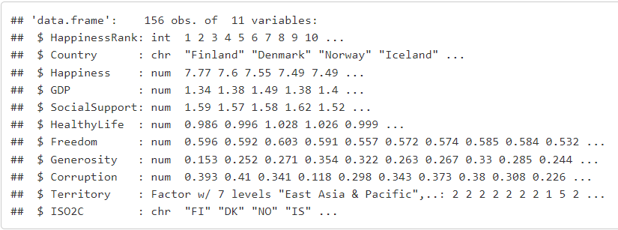
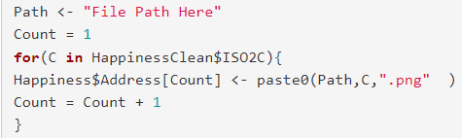
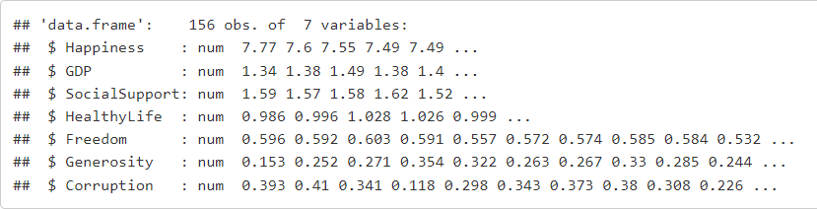
Managing Variable & Cleaning Data
Created factor variable - “Territory”
Created the variable “ISO2C”
Used country flags for our graphs
  Created a string to flag image
  Used a “for loop”
Created a numerical dataset

Slide 7




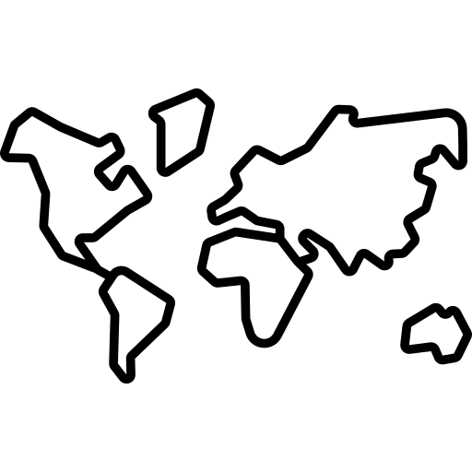
Hypotheses & Predictions
Healthy Life
Generosity
GDP
Social Support
Territory
Higher Healthy Life
Higher Happiness Value
Low Generosity
Low Happiness Value
High GDP
High Happiness Value
High Social Support
High Happiness Value
Territory will affect
Happiness
Notes:
Social support score is the national average score based on responses to the question “If you were in trouble, do you have relatives or friends you can count to help you whenever you need them, or not?”

Slide 8
Tests & Analyses
02
Pearson Correlation Plot
Linear Regression Model
Scatterplot
Box Plot

Slide 9
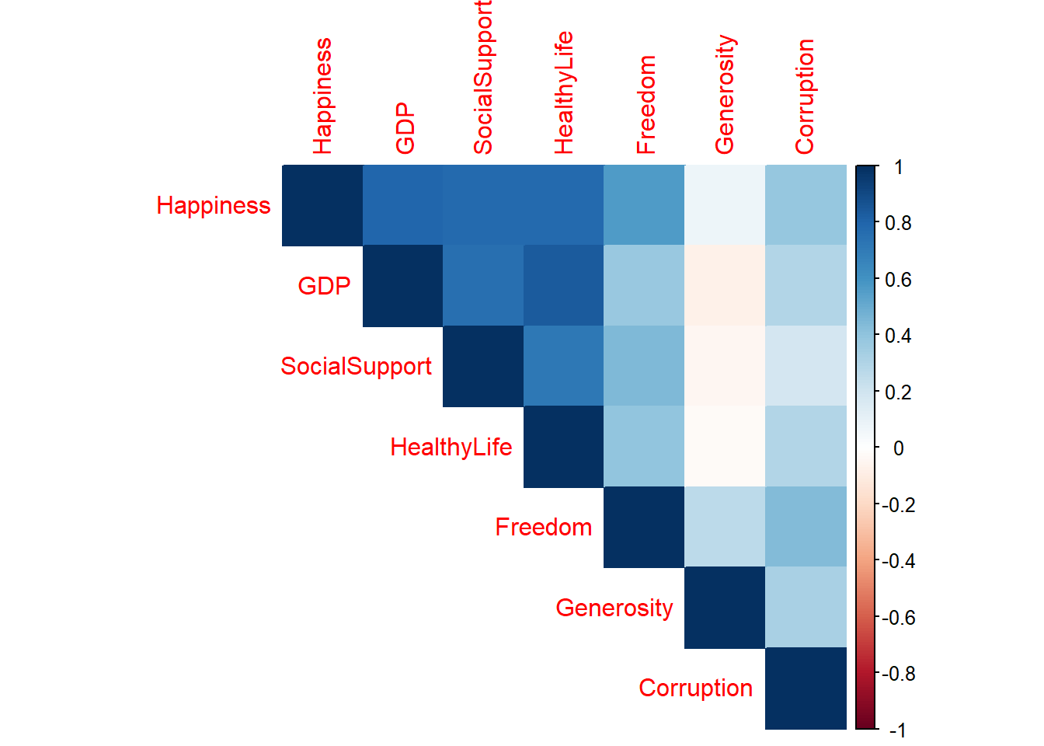
Pearson Correlation Plot
Most (Highest) Correlation:
  GDP
  Social Support
  Healthy Life
Outlier
  Generosity

Slide 10
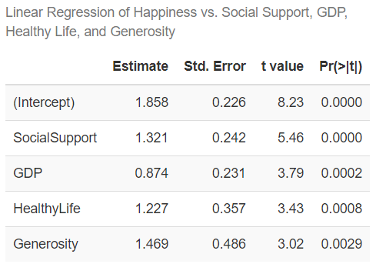
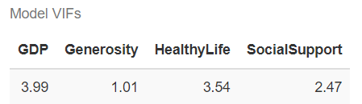
Linear Regression Model & VIF
P-values
  Social Support
  GDP
  Healthy Life
  Generosity
Coefficient of determination:
  r² = 0.742.
VIF
  Multicollinearity

Slide 11
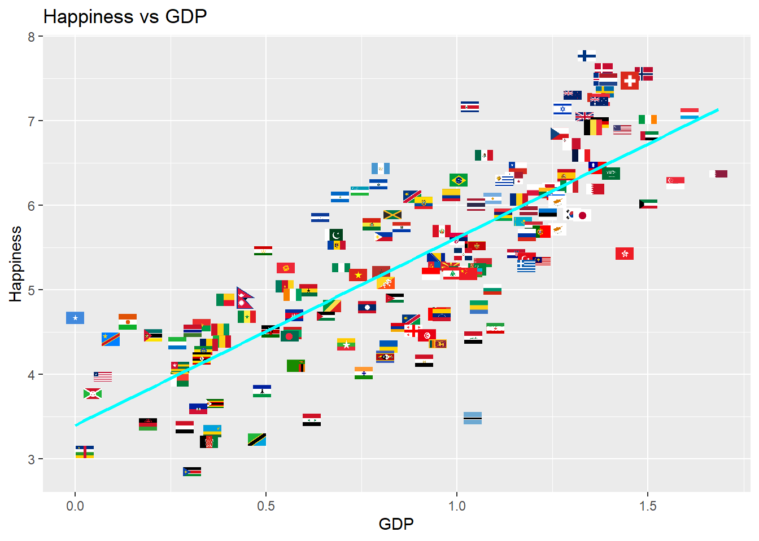
Happiness vs. GDP
Correlation
  Correlation Coefficient:
    0.794
    Highest
Conclusion
P value
  0.0002 < 0.05

Slide 12
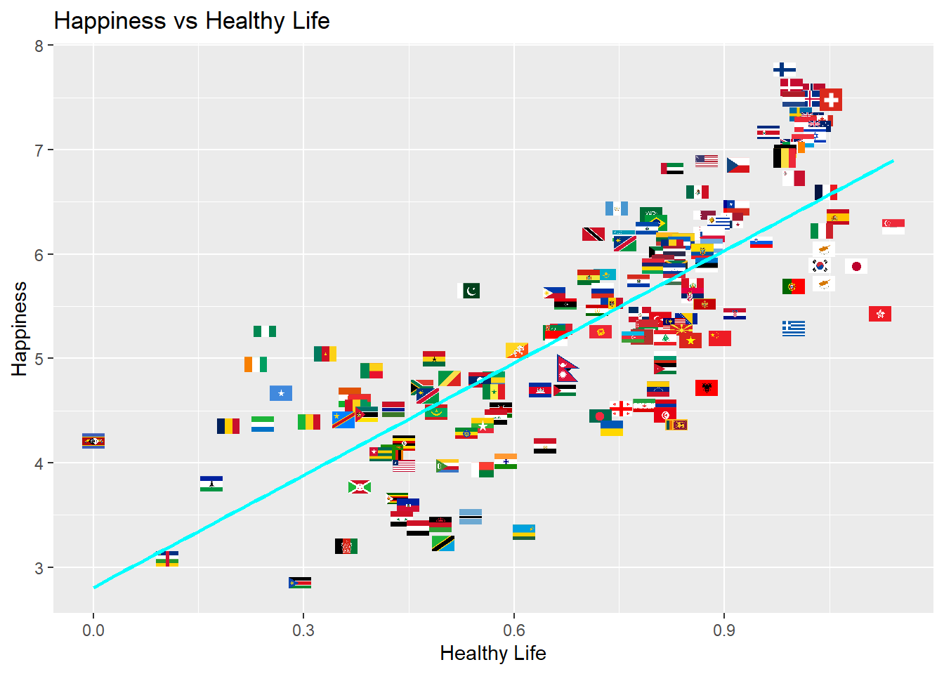
Happiness vs. Healthy Life
Correlation
  Correlation Coefficient:
    0.78
    Second highest
Conclusion
P value
  0.0008 < 0.05

Slide 13
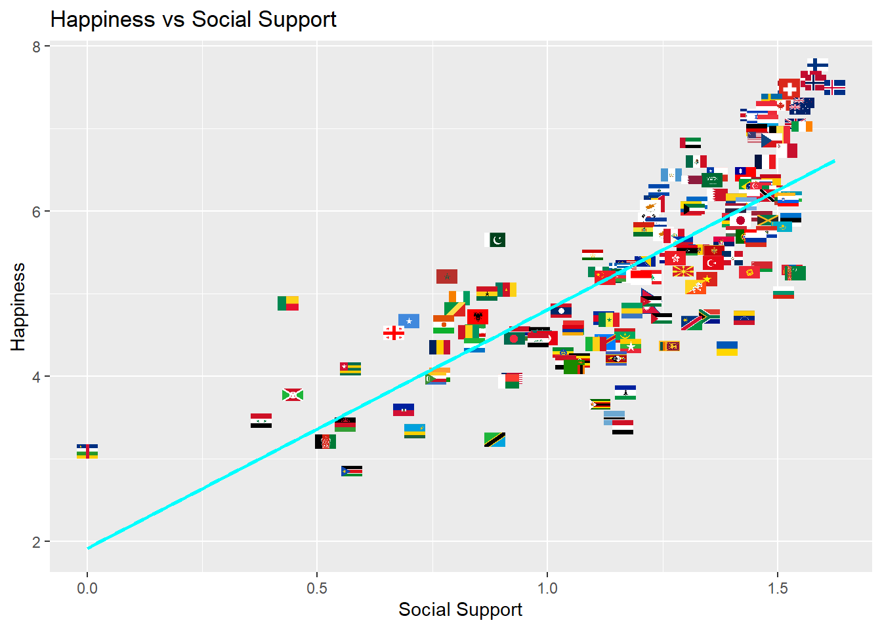
Happiness vs. Social Support
Correlation
  Correlation Coefficient:
    0.777
    Third highest
Conclusion
P value
  0.0000 < 0.05

Slide 14
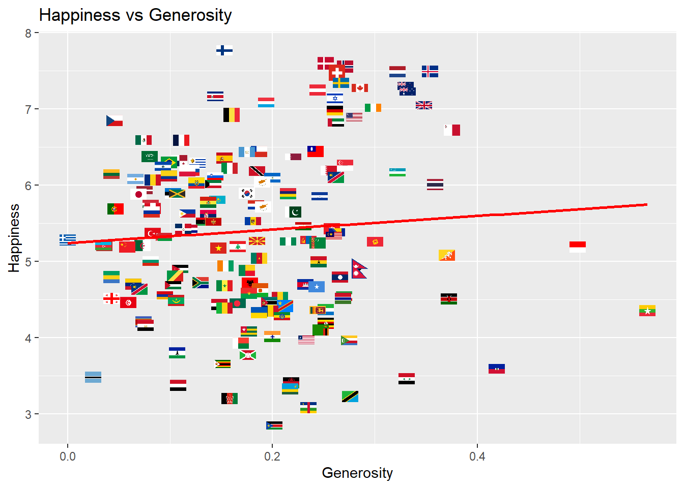
Happiness vs. Generosity
Correlation
  Correlation Coefficient:
    0.0758
    Lowest
Conclusion
P value
  0.0029 < 0.05

Slide 15
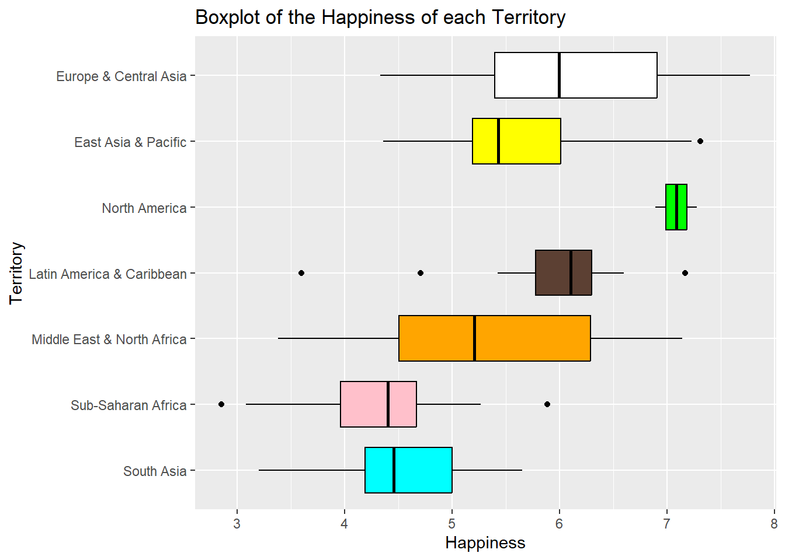
Happiness vs. Territory
High Happiness Score
  Europe & Central Asia
  North America
  Latin America & Caribbean
Middle Happiness Score
  East Asia & Pacific
  Middle East & North Africa
Low Happiness Score
  South Asia
  Sub-Saharan Africa
Conclusion

Slide 16
Conclusion
03
Social Importance
Improvements
Conclusion
Works Cited

Slide 17


Social Importance
Policy Makers
The data can help policy makers interested in increasing happiness in their countries.
Raising Awareness
The data can help promote the importance of well-being and happiness in global societies.

Slide 18


Improvements
The concept of “happiness” is subjective and opinionated.
The data was collected before the introduction of COVID-19.

Slide 19
Conclusion
Answering the SMART Question
Outside Sources

Slide 20
Works Cited
Dylan Graves. (2019).Happier Countries Are More Suicidal: A Look at the World Happiness Report and Suicide Medium
  https://medium.com/@dtg319/happier-countries-are-more-suicidal-a-look-at-the-world-happiness-report-and-suicide-d5f44f69ce8e
UCLA (2022).Does Social Support Have the Biggest Impact on Happiness? World Happiness Report
  https://worldhappinessreport.humspace.ucla.edu/does-social-support-affect-happiness-2/
John F. Helliwell, Richard Layard and Jeffrey D. Sachs. (2019). World Happiness Report. Sustainable Development Solutions Network
  https://worldhappiness.report/ed/2019/
Matthews, L. (2022). “The world’s happiest country is all about reading, coffee, and Saunas.” AFAR Media.
  https://www.afar.com/magazine/the-worlds-happiest-country-is-all-about-reading-coffee-and-saunas.

Slide 21
Thank You!
Please keep this slide for attribution

